Slide 1
Pointers

Slide 2
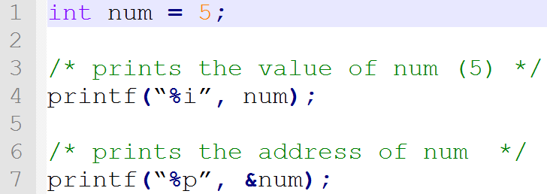
Location, Not Data
Sometimes want to talk about data's location
Location is called an address
All data has an address
Can see address using the & operator (remember scanf?)

Slide 3
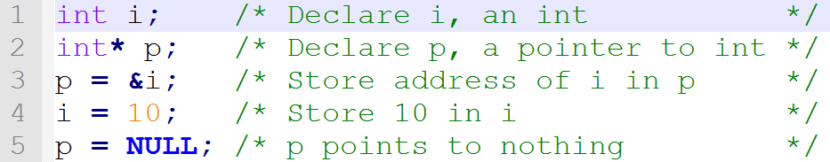
Pointers
Can store an address in a pointer
Must specify what type of data is stored at the location
Adding * after the type during declaration denotes it's a pointer
NULL – Address that points to nothing

Slide 4



Visualizing Pointers
int i; /* Declare i, an int */
int* p; /* Declare pointer to int */
p = &i; /* Store address of i in p */
i = 10; /* Store 10 in i */

Slide 5
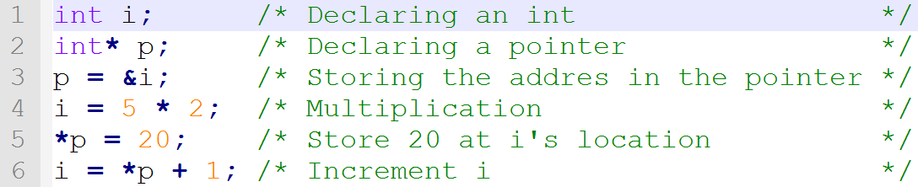
Getting At The Data
To access the data, use the * (dereference) operator
* has many uses, depends on the context

Slide 6
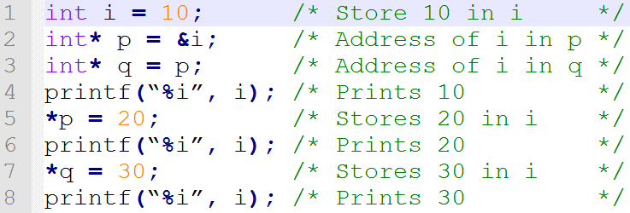
Another Example

Slide 7
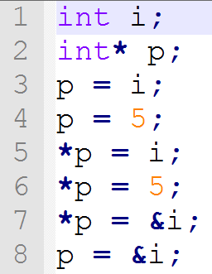
Type Checks Which of these are ok?

Slide 8
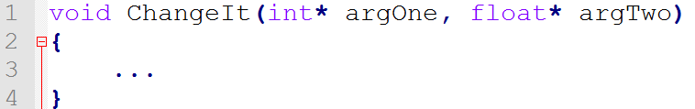
Passing Pointers To Functions
Can only have 1 return value
What if we want more?
Pass a pointer (location) instead
Allows us to get directly at the data

Slide 9
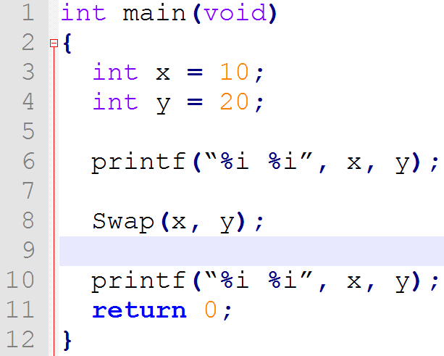
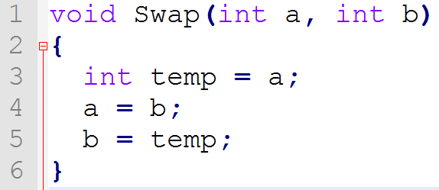
Incorrect Swap Function

Slide 10
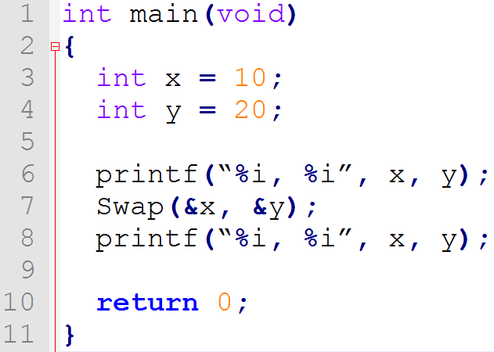
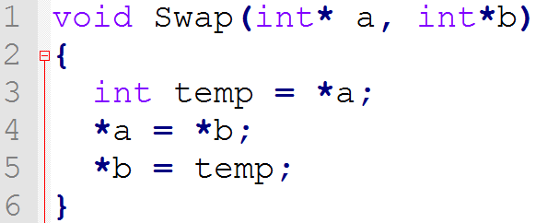
Correct Swap Function

Slide 11
Pointer Operators
Can use a few arithmetic operators on pointers
pointer + integer = pointer
pointer – integer = pointer
pointer – pointer = integer
Can also use relational and equality operators
pointer == pointer (address is the same)
pointer != pointer (different addresses)

Slide 12
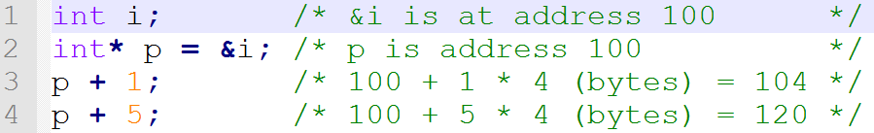
Pointer Arithmetic
Adding/Subtracting an integer moves the address by that number * size of the type being pointed to:

Slide 13
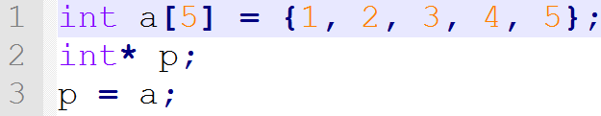
Pointers And Arrays
Since pointers and arrays both point to a location, we can do this:
What do we get if we deference p?

Slide 14
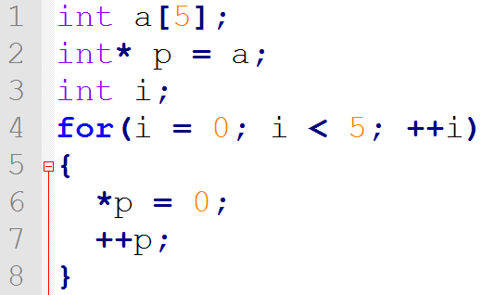
Iterating An Array With A Pointer
Set all the values in an array to 0 using pointers:

Slide 15
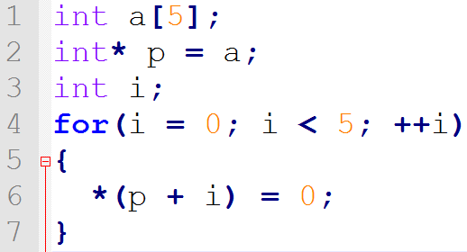
A Bit More Compicated Same Result

Slide 16
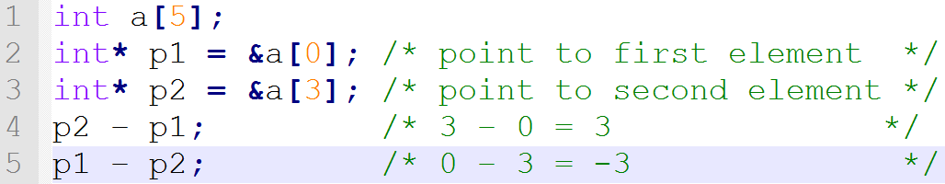
Pointer Arithmetic Cont.
Subtracting a pointer is only valid if both pointers are in the same array
Gives the difference in elements

Slide 17
Relational/Equality Operators
<, <=, >, >= only valid if pointers are in the same array
Compare the position in the array
==, != can be used with any pointer
Checks if it's the same location

Slide 18
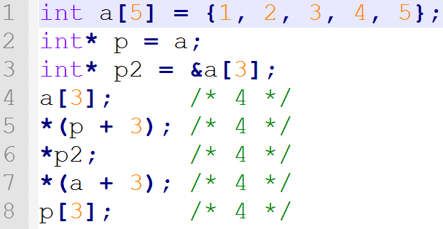
Subscripts and Pointers
Subscript operators are actually a shortcut
It offsets the pointer, then dereferences

Slide 19
Passing Arrays To Functions
Can't really pass an array to a function
Passes address of array instead
void MyFunc(int array[]);
is actually
void MyFunc(int* array);
We will be using the second definition from now on
You can use pointer arithmetic or sub scripting in the function, your choice

Slide 20
Summary
Pointers store the address of some data
Can access that data using the * (dereference) operator
Can move and compare pointers using pointer arithmetic
Passing a pointer to a function will let the function modify the data the pointer is pointing to

Slide 21
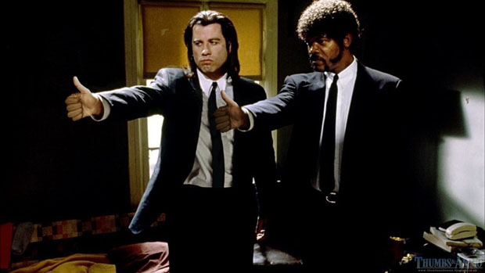
Questions?

